Slide 1
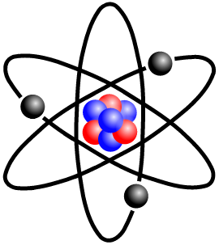
Atom Modeling
Using abstraction make tiny particles come to life

Slide 2
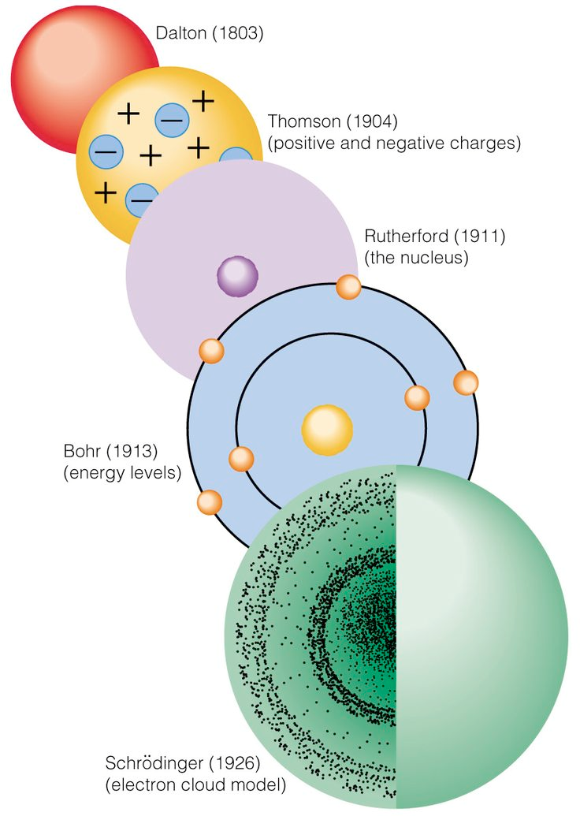
Atom Modeling Project - Overview
You are going to create atomic models today!
In fact, you will create three different models:
Digital, using a Build an Atom simulation
On paper, drawing your results from the simulation
Physical, using wire and foam beads

Slide 3
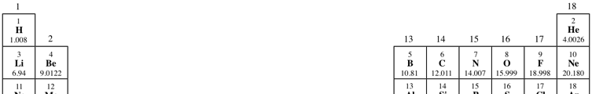
Get into teams and choose your elements
You can choose any five of these nine elements on the periodic table:
Helium
Lithium
Beryllium
Boron
Carbon
Nitrogen
Oxygen
Fluorine
Neon

Slide 4
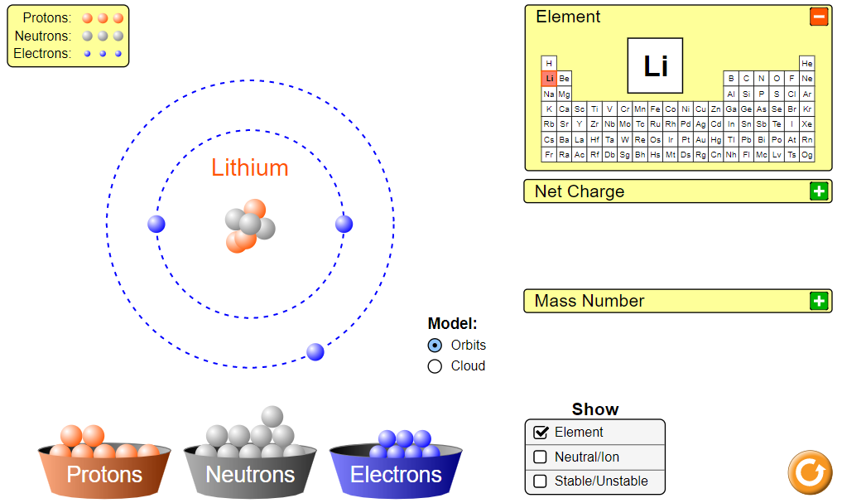
Demo: Build an Atom simulation
Notes:
Click the image to launch the simulation

Slide 5
Your turn - create your digital and paper models
Create your first atom of your element by dragging protons, neutrons and electrons onto the model.
Your atom should not be an ion - it should have a neutral charge.
Use the periodic table to help determine how many protons, neutrons and electrons you need
Don’t forget to record your results onto your handout before moving on to a new element

